Slide 1
Using Machine Learning Methods To Predict Wine Quality
DH 150 Machine Learning
Zesen Ma

Slide 2
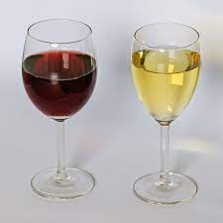

Data
Dataset Description: This dataset is about Vinho Verde wine samples, from the north of Portugal(more info can be found here: https://www.vinhoverde.pt/en/homepage). The data is divided into white and red wine samples. Variables in this dataset are mainly related to the physicochemical quality aspect of the wine, the properties of the wine, such as residual sugar, acidity, density, color, alcohol and so on.

Slide 3

Source:
The dataset is public available for research purposes only. UCI ML repo,
The first related published work: Modeling wine preferences by data mining from physicochemical properties
Author:

Slide 4
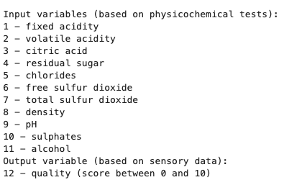
Features in Data:

Slide 5
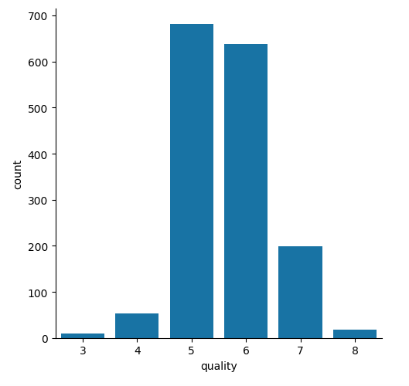
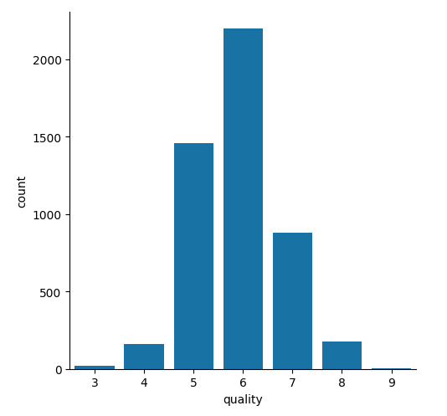
Data explore:
No Missing Values
Red wine: 1599
White wine: 4898

Slide 6
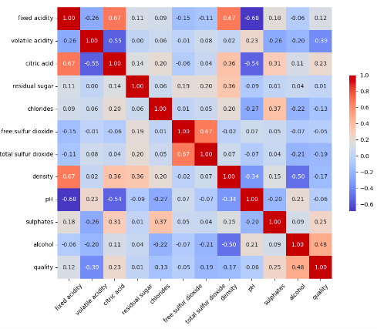
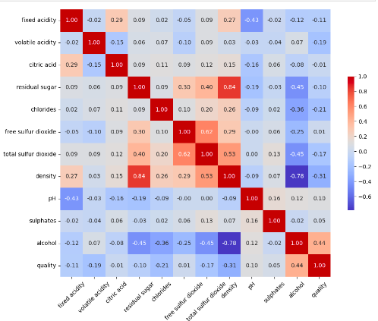
Correlation Heat Map:

Slide 7


First Approach:
Using linear regression and Random Forest to predict the quality rating of the wine dataset.
Feature Scaling:
I find that for example: free sulfur dioxide might be measured in mg/L and pH is a scale from 0 to 14 and alcohol is typically measured in percentage by volume (% vol).

Slide 8
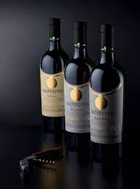
Classification:
For the interest of research, in the real world, most wines are not labeled with numbers, for its quality. It makes more sense to label the quality of wine using "good" "premium quality". In this case, for this wine data set, since we have much more data for the white wine, and looking at the quality distribution among the white wine. I have decided to label all wine with a rating higher or equal to "premium quality", and use white wine data as the main research base.

Slide 9
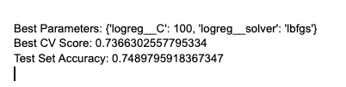
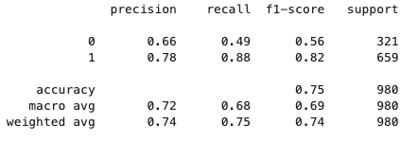
Logistic Regression
Logistic Regression models are not only quick to train but also offer insights into the relationship between features and the target variable.

Slide 10

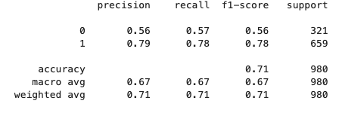
Naive Bayes:
chosen for its simplicity and efficiency. Despite its assumption of feature independence, which may not hold true in our case but Naive Bayes can perform surprisingly well in classification tasks. Its inclusion is motivated by the desire to have a baseline model.

Slide 11

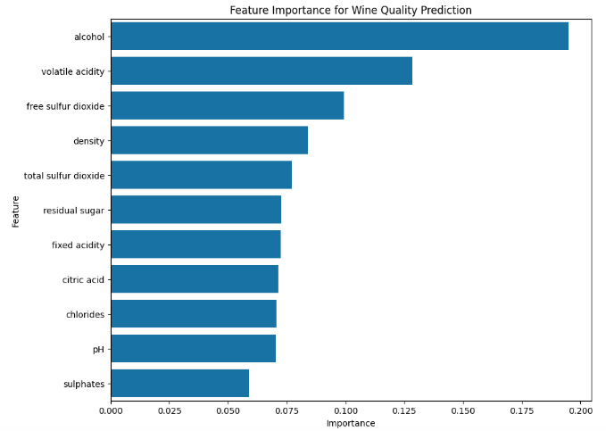
Decision Tree:
Using it making it easier to explain which features are most influential in determining wine quality. This method is particularly valuable when the goal is to gain insights into the decision-making process, such as identifying the physicochemical properties that most significantly impact wine quality.

Slide 12
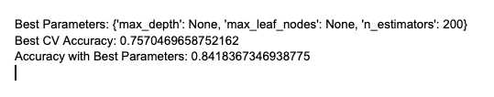
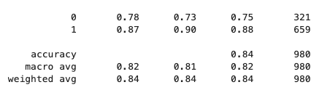
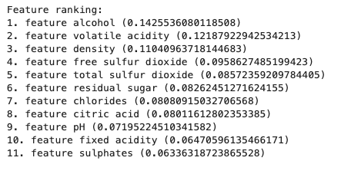
Random Forest:
enhances the model's generalization capabilities, making it a strong candidate for achieving higher accuracy in wine quality prediction.

Slide 13
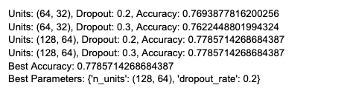
Neural Network:
acknowledges the possibility that the relationships between the physicochemical properties of wines and their quality ratings are complex and might be better captured through deep learning

Slide 14
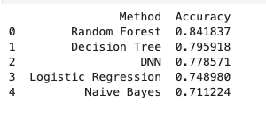
Overall:
concerning all factors, random forest and decision trees are both suitable options for predicting wine quality. (Further analysis on model classification reports can be found in the section below)

Slide 15
Other aspect:
Bias: classification report , quality distribution of the wine data
Ethics: Public used dataset, the rating of quality is highly subjective, and the data is not generalizable, since the data is collected from a specific region.
Since it has commercial used, the data did not indicate what types of grapes and growing process, due to privacy reasons.
Model selection and accuracy: Previous work achieved higher accuracy in theri ML methods. Future improvements are needed. Better model selections and optimizations.

Slide 16
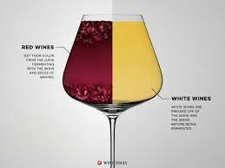
More Info:
Can be found inside the jupyter notebook report

